Slide 1

The Google File System
Sanjay Ghemawat Howard Gobioff and Shun-Tak Leung
Xun Hao
18210240232
Feng Rui

Slide 2

Contents
BUSINESS REPORT
0 BACKGROUP
1 DESIGN OVERVIEW
2 SYSTEM INTERACTIONS
3 TESTING

Slide 3
Backgroup
01

Slide 4
Question
what's distributed file system?

Slide 5
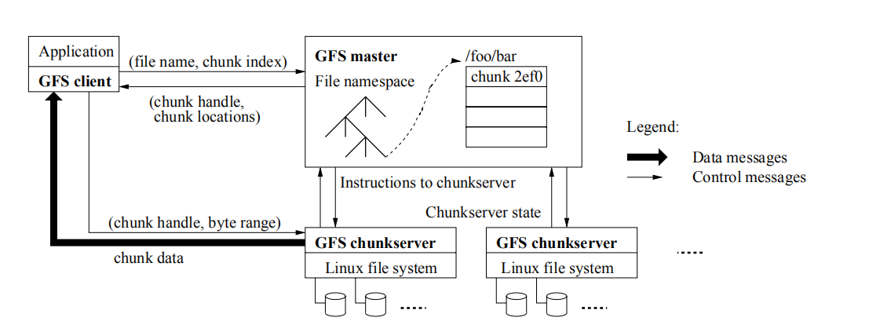
DESIGN OVERVIEW
Architecture

Slide 6
DESIGN OVERVIEW
Single Master
Having a single master vastly simplifies the design and enables the master to make sophisticated chunk placement and replication decisions using global knowledge.
Chunk Size
64 MB
Metadata
The master stores three major types of metadata: the file and chunknamespaces, the mapping from files to chunks,and the locations of each chunk’s replicas.

Slide 7
DESIGN OVERVIEW
Architecture

Slide 8
DESIGN OVERVIEW
Single Master
Having a single master vastly simplifies the design and enables the master to make sophisticated chunk placement and replication decisions using global knowledge.
Chunk Size
64 MB

Slide 9
Metadata
DESIGN OVERVIEW
The master stores three major types of metadata: the file and chunknamespaces, the mapping from files to chunks,and the locations of each chunk’s replicas.
In-Memory Data Structures
Chunk Locations
Operation Log

Slide 10
DESIGN OVERVIEW
Consistency Model
File namespace mutations (e.g., file creation) are atomic.
By applying mutations to a chunk in the same order on all its replicas
Using chunkversion numbers to detect any replica that has become stale because it has missed mu_x0002_tations while its chunkserver was down
 | Write | Record Append
Serial success | defined | defined interspersed with inconsistent
Concurrent successes | consistent but undefined
Failure | inconsistent

Slide 11
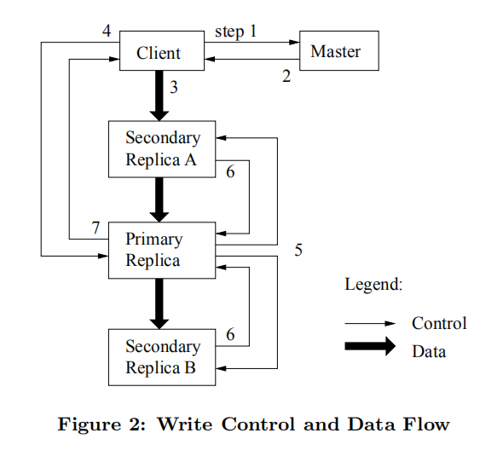
·Leases ·Mutation Order
SYSTEM INTERACTIONS

Slide 12
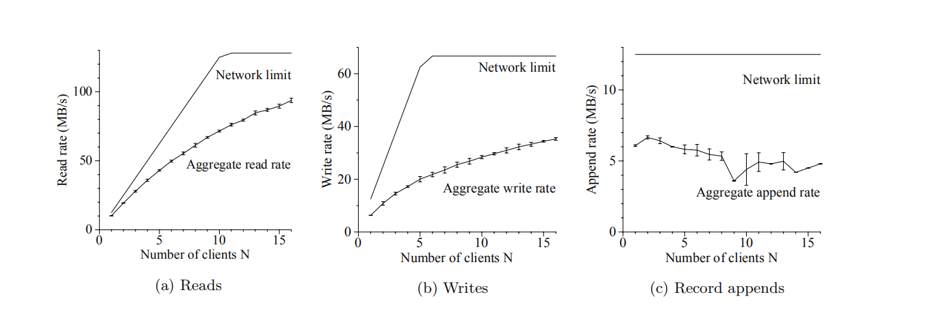
TESTING

Slide 13

Discussions

